Slide 1


Office 2007 End of Support

Slide 2

Office 2007 End of Support is here.
It has been 10 years since we launched Office 2007 and it has reached the end of its support lifecycle.
As of October 10, 2017, the following products will no longer be supported:
Office 2007
Office for Mac 2011

Slide 3
How will this impact your
day-to-day operations?
What is the risk to your business?
No new security updates
No new features, updates or bug fixes
No online technical content updates
Reduced functionality when integrating with modern versions of Office servers and Office 365 services
Microsoft product support to fix issues is not available
Custom support agreements are not available
Outlook 2007 clients using Office 365 will not be supported*
*As of October 31, 2017, Outlook 2007 clients using Office 365 will not be able to receive support. For more information, see RPC over HTTP deprecated in Office 365 on October 31, 2017

Slide 4
The evolution of Office: Then vs now
Meeting the demands of a modern workplace
2007
2017
Built for teamwork
Share files and manage workflow
Real-time co-authoring
Instantly meet with voice, video and chat
Mobile
Flip phones, laptops
Get mobile first, mobile everywhere
Access files anywhere, on your devices
Professional results in minutes with built-in icons, templates and charts
Maximum Productivity
Standard Features
Intelligence
Bring complex data to life with Artificial Intelligence, machine learning and data visualization tools
Business Intelligence
Trust
Nation states, hacktivism, ISO 27001, ISO 27018, FERPA, UK G-Cloud
Malware, HIPPA, SOX

Slide 5

Upgrade now. Get these enhancements and more.
Access files anywhere – online or offline
Protect your company and customer data with enterprise-grade security
Work together on documents with your coworkers with co-authoring
View previous versions of files so you can track and compare document changes as they progress
Create professional presentations in minutes, with a large selection of built-in charts, graphs and templates
Remain always up-to-date with the latest versions of Office

Slide 6



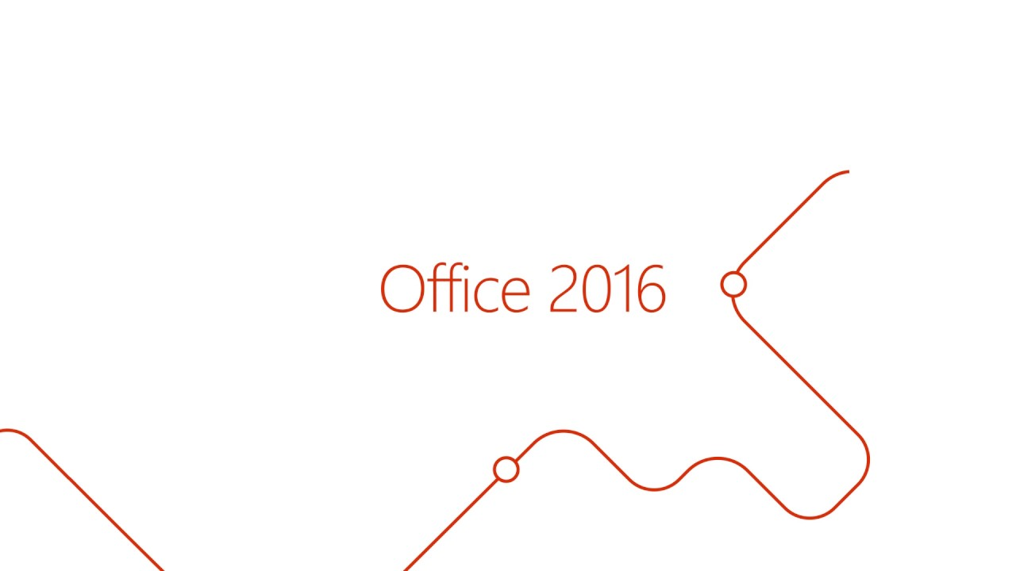
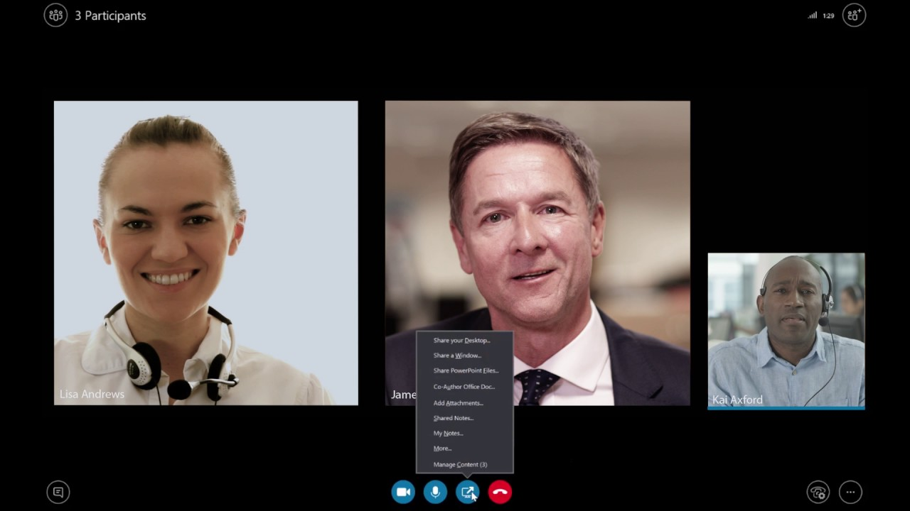

Benefits of the cloud: Saves time and effort
Get the same Office 365 tools you know and love, with new capabilities to help your day-to-day operations
Check out these videos:
Collaborate in real time
Presentation prep simplified
File share anywhere
Data visualization streamlined
Meeting productivity evolved
Timesaving email attachment

Slide 7

Customer stories: Small businesses win with Office 365
Size: Small (1-49 employees)
Industry: Retail and Consumer Goods
Location: US
Size: Small (1-49 employees)
Industry: Professional Services
Location: US
Fishs Eddy sets the table for growing business with Office products
Law firm adopts cloud suite to amplify services and help safeguard client trust
“Our technology was all over the place; data on local computers, some on our server. We didn’t have anything centralized. During Hurricane Sandy, we lost power and our server crashed. We needed to move our data and programs to the cloud—specifically, our email. We moved our mail to Microsoft Exchange and adopted Office, which helped improve data security and enabled us to work remotely.”
- Noah Lenovitz, Partner
Full Story
“When a client provides us with confidential information, it’s critical we protect that information. In the same way that my client has to trust me, I have to trust the technology my firm relies on, and I know that I can with Office 365.”
John Browning, Founder and President
Full Story

Slide 8
Avoid disruption to your business in
3 steps
1
2
3
Choose your approach
Choose your product
Migrate

Slide 9

Step 1: Choose your approach
Select between on premise or the cloud
Most Popular Option
1. Move to the Cloud with Office 365
Migrate your old Office 2007 clients and services to Office 365, which is always available and always up-to-date. You’ll never have to worry about upgrading again.
Office 2007
Clients & Servers
1. Upgrade to Office 2016 Clients & Servers
Intermediate Steps to Server Updates
(Exchange & SharePoint)
Take advantage of your Software Assurance benefits to update or replace your on-premises infrastructure.

Slide 10

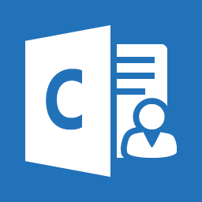
Step 2: Choose your product
The best way to get Office is through the cloud
Office 365 Business
Office 365 Business Premium
$8.25 user/month
$12.50 user/month
Office Apps:
Office Apps:
For PC Only
For PC Only
For PC Only
For PC Only
Office 365 Services:
Office 365 Services:
Bookings
Customer Manager
Desktop versions of Office 2016 applications: Outlook, Word, Excel, PowerPoint, OneNote, plus Access and Publisher for PC only
1 TB of OneDrive for Business storage per user
One license covers 5 PCs or Macs, 5 phones, and 5 tablets per user
Maximum number of users: 300
24/7 phone and web support
Licensed for commercial use
Always up-to-date Office applications
Business class email hosting with 50 GB mailbox
Custom domain name address (name@yourcompany.com)
1 TB of OneDrive for Business storage per user
One license covers 5 PCs or Macs, 5 phones, and 5 tablets per user
Host unlimited HD video conferencing for up to 250 people with Skype for Business
Chat-based workspace to connect your teams with Microsoft Teams
Maximum number of users: 300
24/7 phone and web support
Licensed for commercial use
Always up-to-date Office applications

Slide 11
Step 3: Migrating is easy and secure
MYTH
REALITY
Keeping data on premise is safer than in the cloud.
Security and 99.9% financially-backed uptime guarantee come standard with Office 365.
If our data moves to the cloud, our business will no longer have control over our technology.
Your data is yours. You still have control over your data. We safeguard it and protect your privacy
I won’t have control over my environment in the cloud, making it harder to manage.
Office 365 takes care of IT for you, so your services are always up and running and up to date. You get full control over your settings and environment.

Slide 12


Upgrade today:
Partner Contact Information
(Name)
(Phone Number), (Email Address)
For more information, visit these links:
Support is Ending for Office 2007
Support is Ending for Mac 2011
© Copyright Microsoft Corporation. All rights reserved.

